Slide 1
UML Diagrams
of
Edu-Right
180041203
Md. Sajid Altaf
180041204
Syed Mohammed Sartaj Ekram
180041219
Adham Arik Rahman

Slide 2
Diagrams
Use Case Diagram
Activity Diagram
Sequence Diagram
Class Diagram

Slide 3
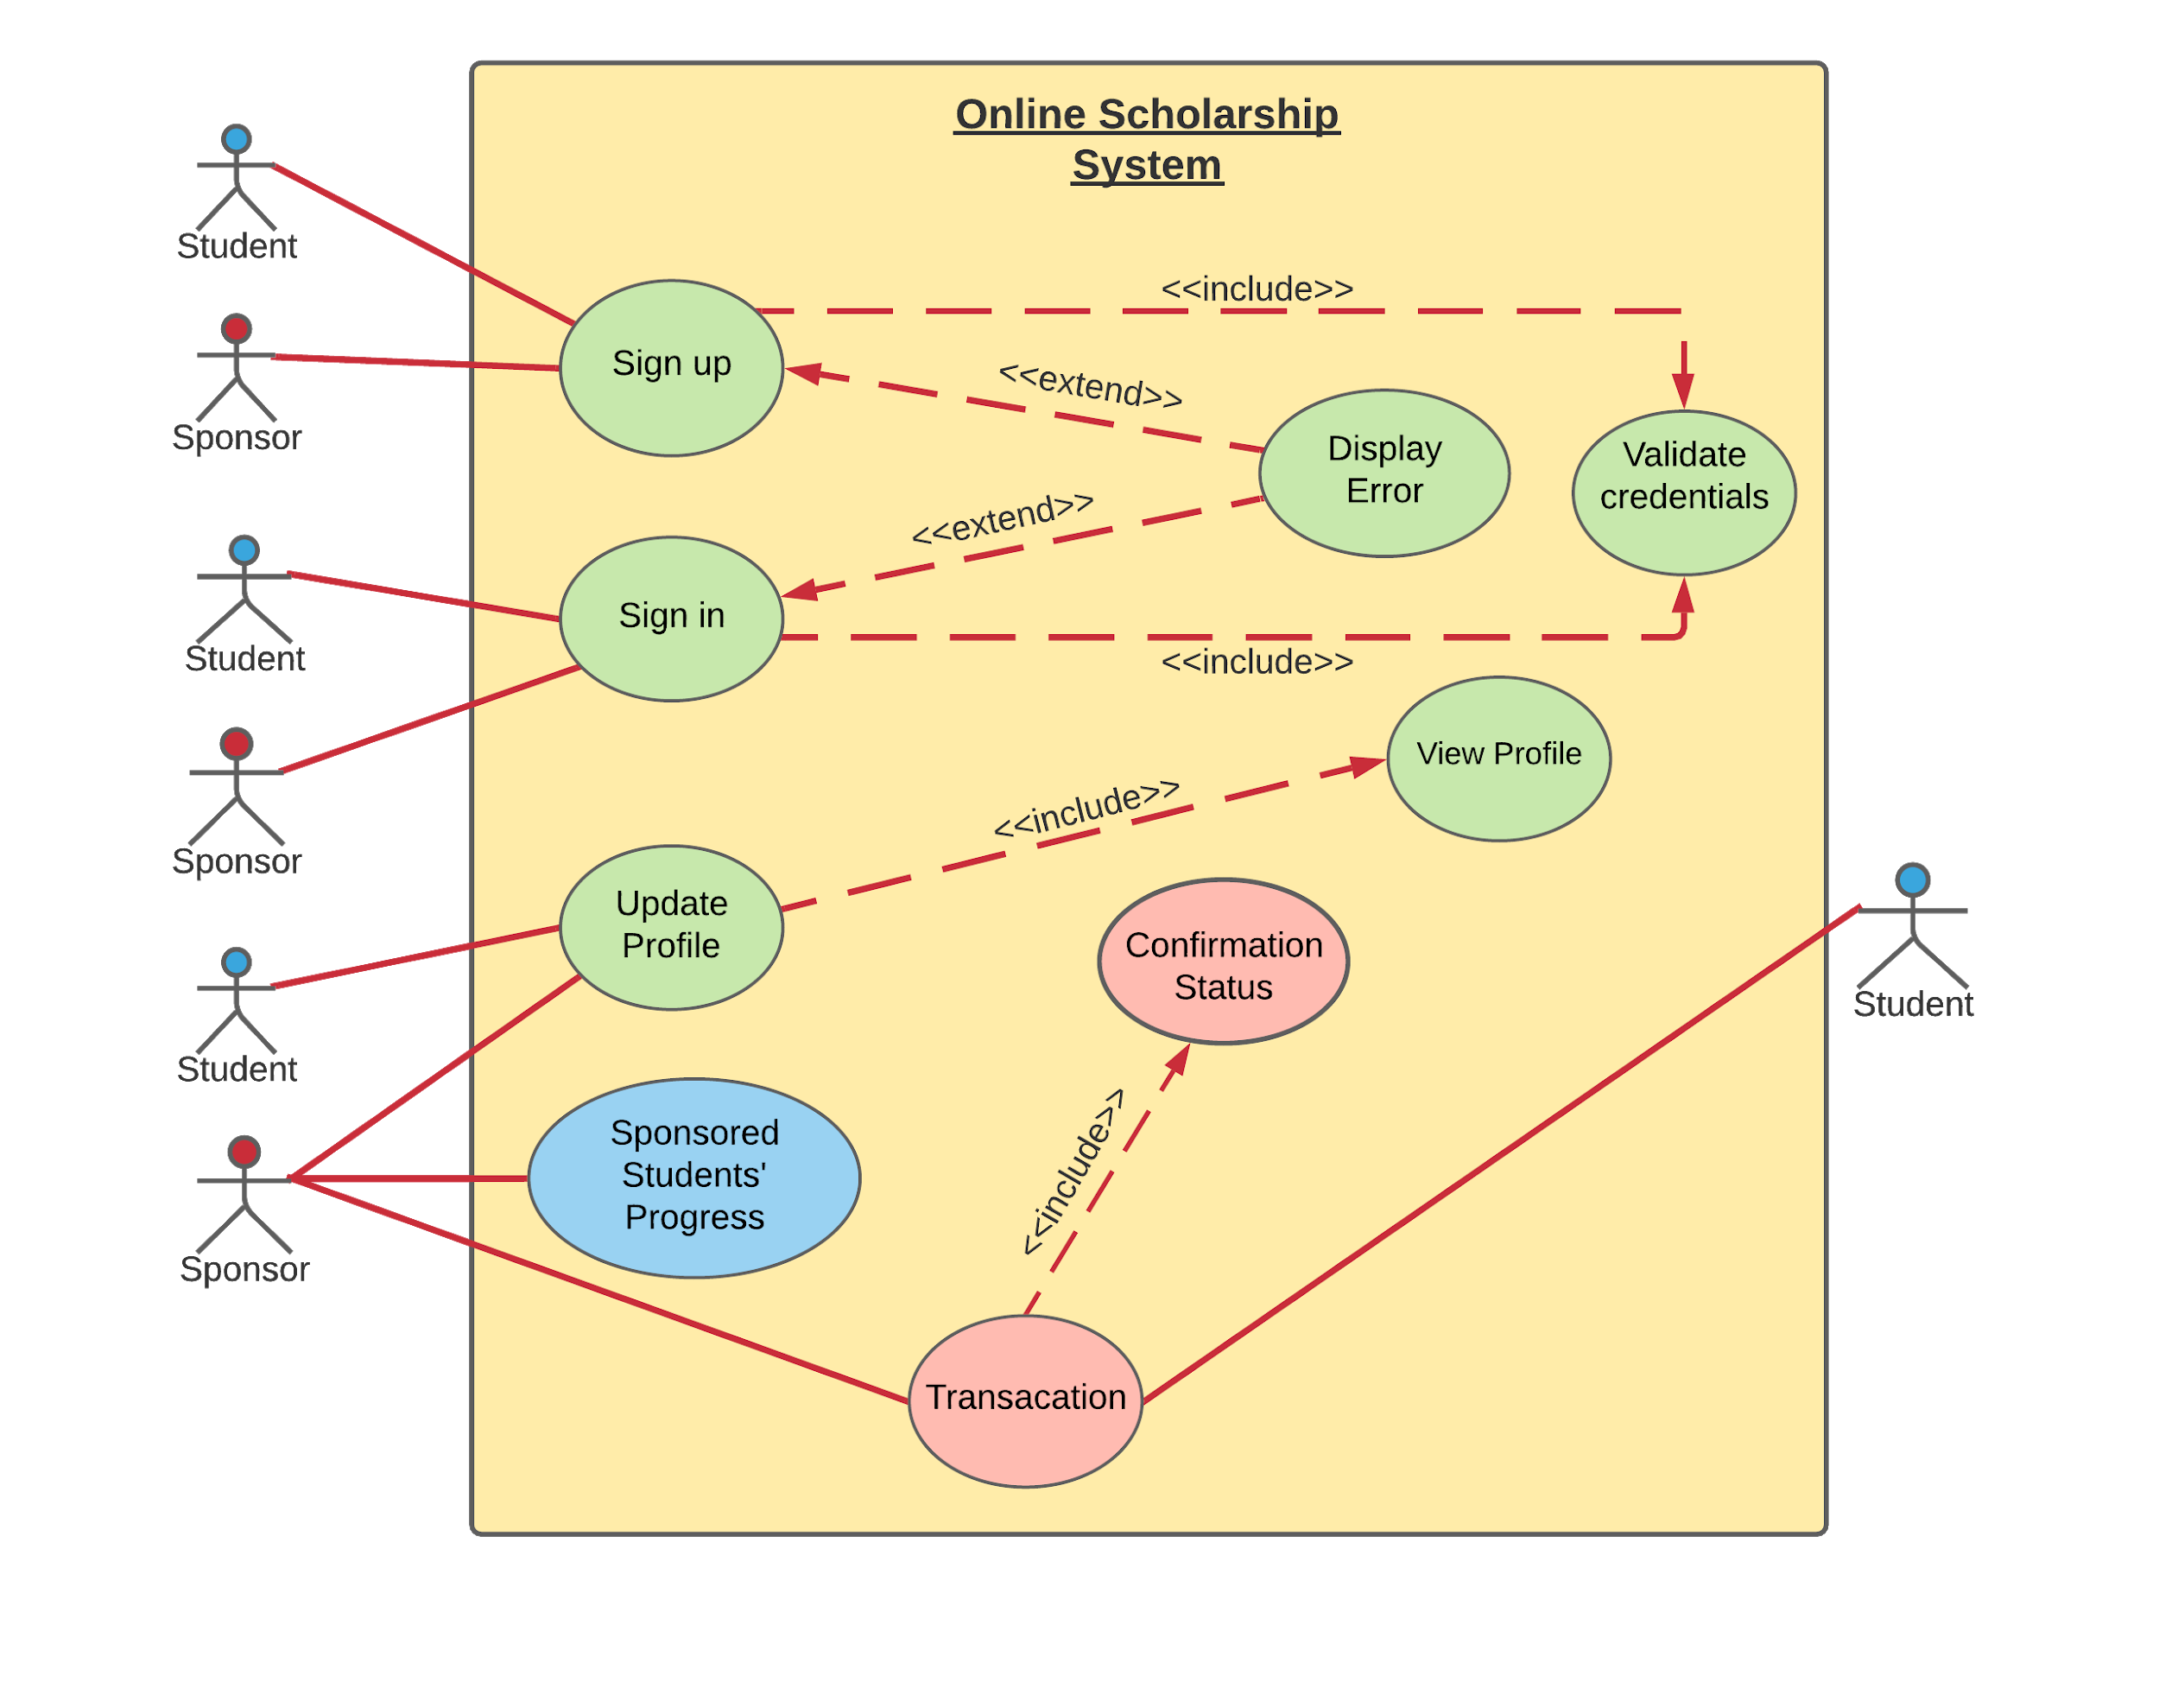
Use Case Diagram

Slide 4
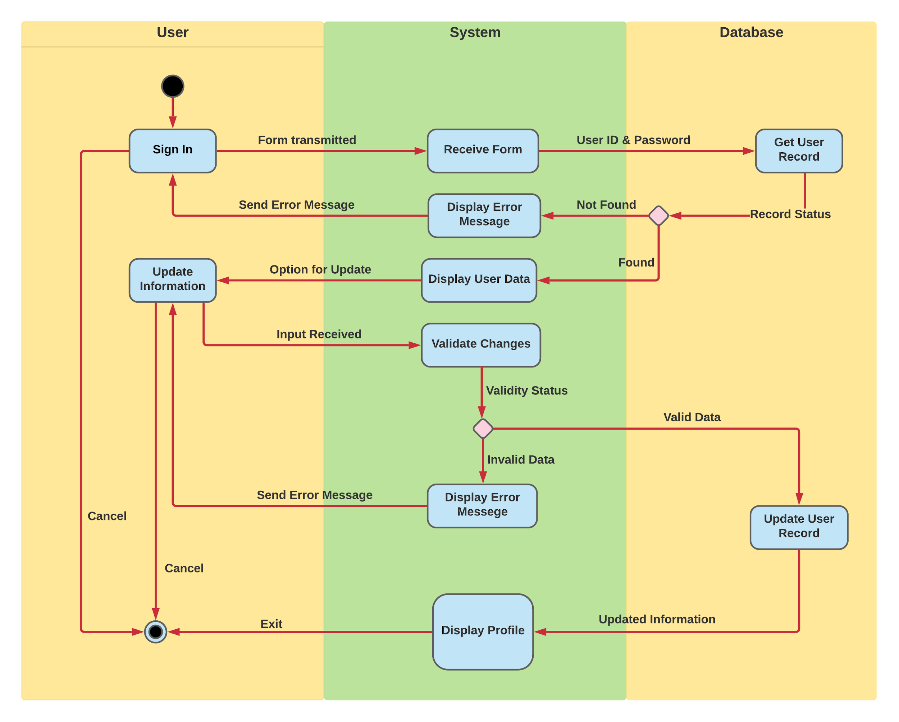
Activity Diagram

Slide 5
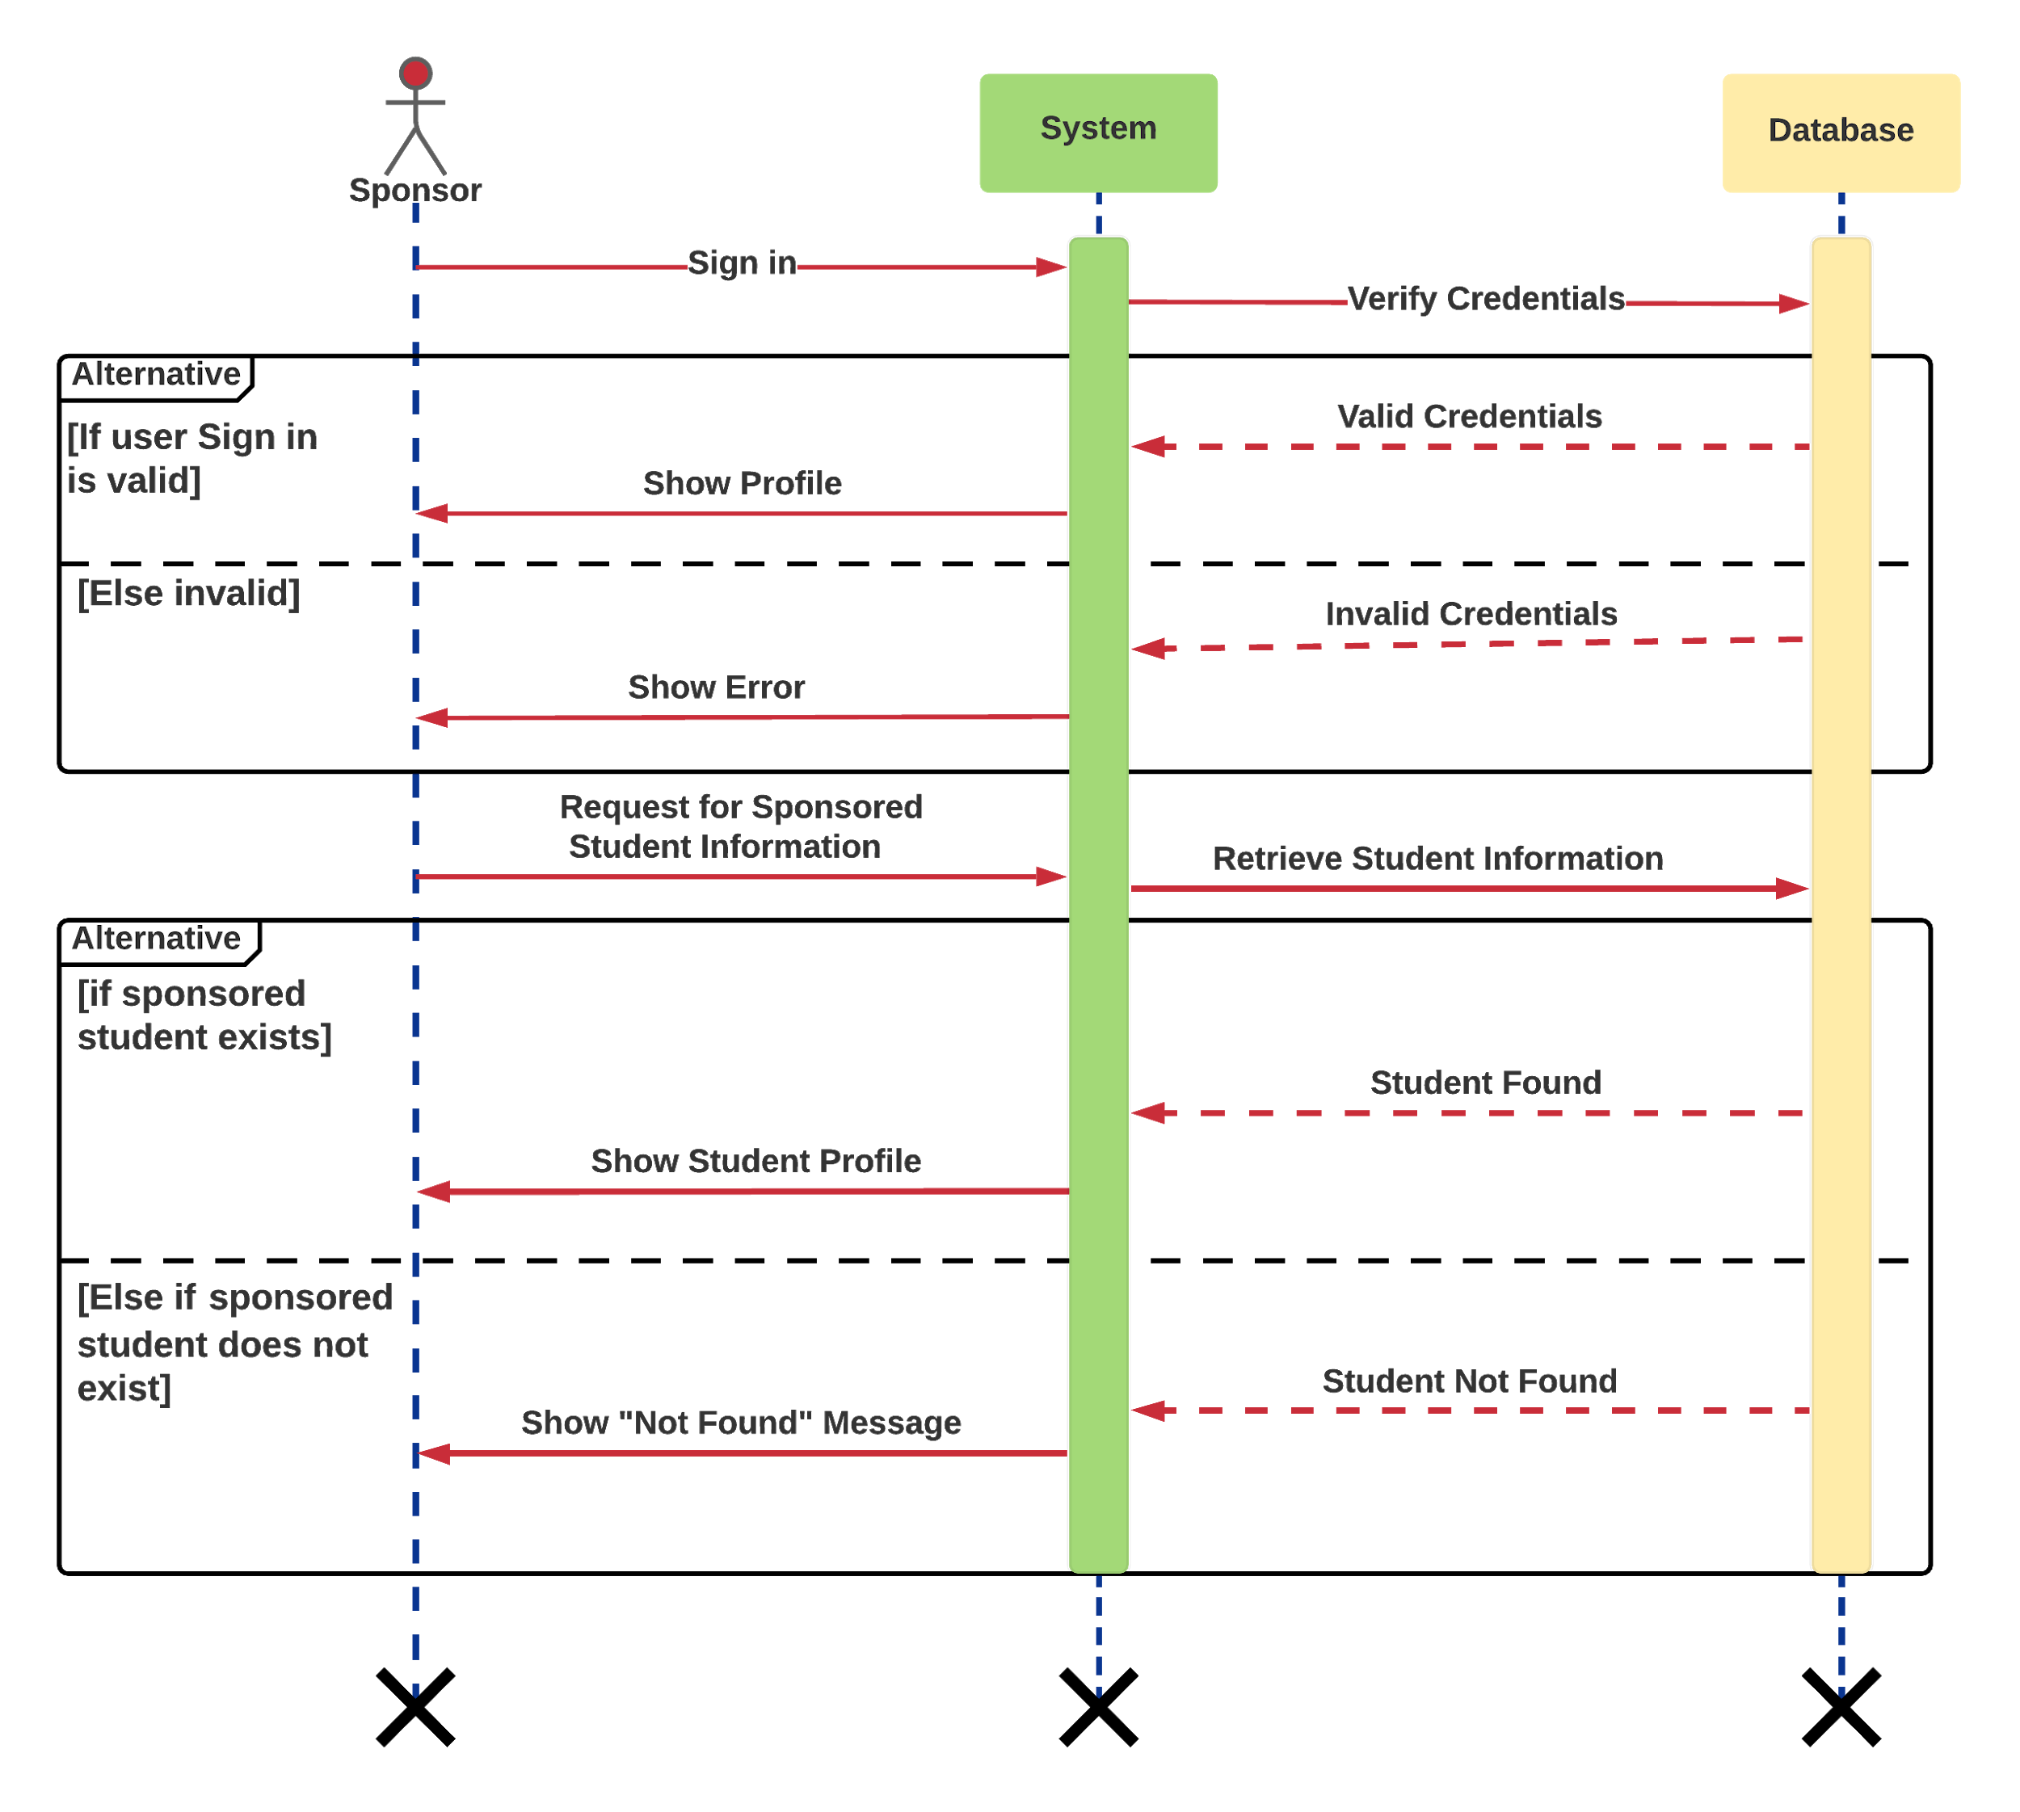
Sequence Diagram

Slide 6
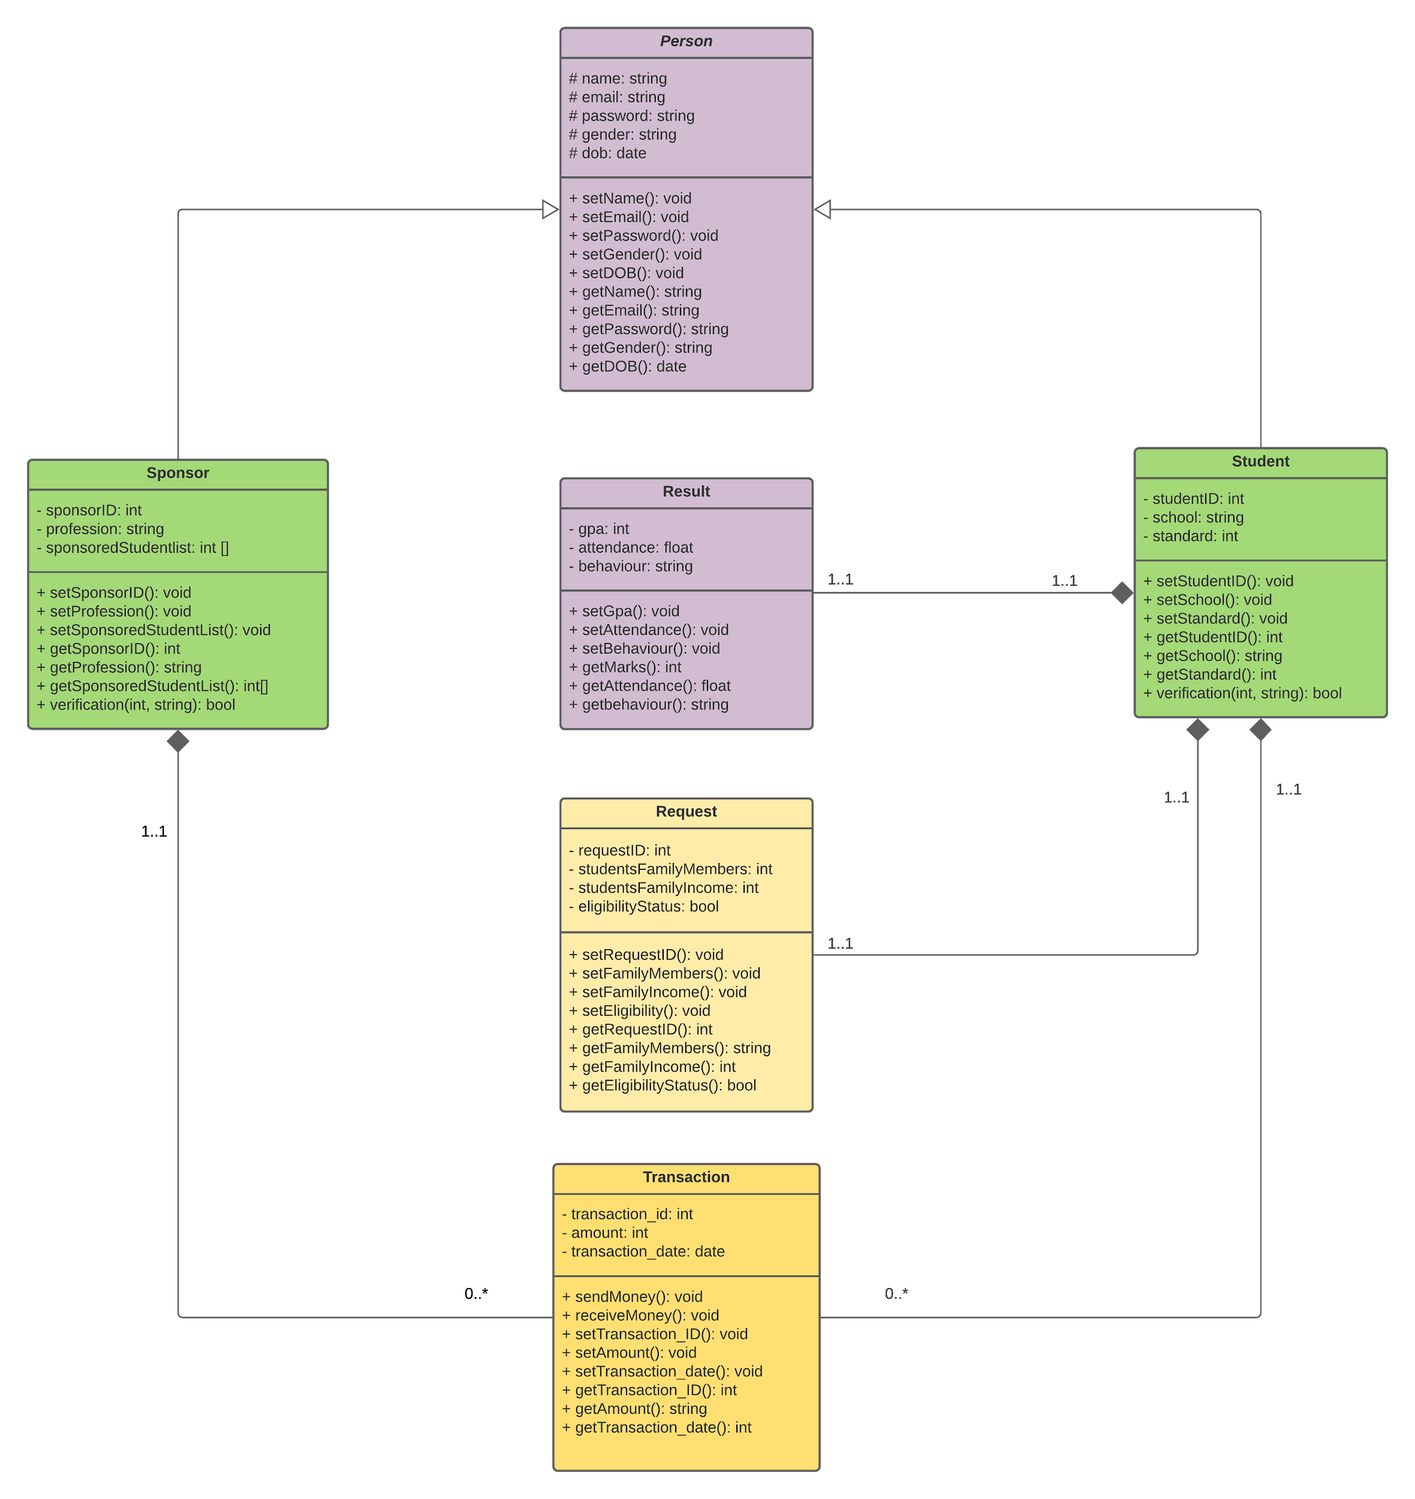
Class Diagram

Slide 7
Thank You

